Slide 1
Turing Test

Slide 2
In the year 1950 Mr. Alan Turing(famous computer scientistis) proposed the Turing Test.
He Said that : Turing test is used to determine "whether or not machines can think intelligently like humans?"

Slide 3

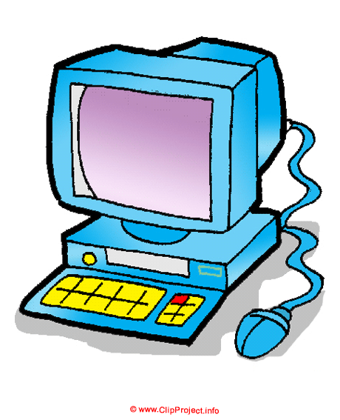
Human
Computer
Interrogator

Slide 4
There will be a human interrogator on the side of the wall and the other side a machine and a human. The interrogator is going to ask a question via teletype, both the machine and human present on the other side will answer to the question via teletype. If the interrogator can not distinguish the answer provide by the machine or the human then the machine passes the test and the machine is considered as intelligent(or thinking intelligently like humans.)

Slide 5
Chinese room Test

Slide 6
In the year 1980, Mr. John Searle proposed the "Chinese room Test"
He argued that turing test could not be used to determine "whether or not a machine is considered as intelligent(or thinking intelligently like humans.)"
He said that : just because of the machine can be able to answer like humans, it should not considered as intelligent.

Slide 7
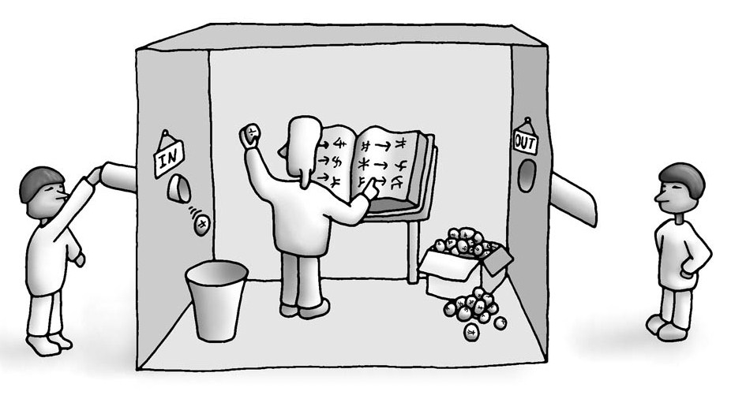

Slide 8
A machine could pass the turing test simply by manipulating symbols without any understanding of those symbols. A person or machine can be considered as intelligent, if and only if they do have an understanding of what they are doing. Without understanding, they could not be considered as intelligent. Therefore, the Turing Test cannot be used to determine "whether or not a machine is considered as intelligent?"

Slide 9
A person who knows English but not Chinese sits in the room. He has an access to a huge volume of Chinese literature; written like this:
If u find a Chinese symbol # then return this Chinese symbol $.
Receives i/p in Chinese . He refers the rule ledger for producing outputs. Returns output in Chinese . The inside person has no understanding of what these symbols mean, but from outside the room it looks like the inside person knows Chinese perfectly.

